Slide 1
Falls Township Police Department
Hiring Process and FTO Program
2020

Slide 2

Falls Township
POPULATION: 34,300
26.6 square miles total area
22.3 square miles of land area

Slide 3
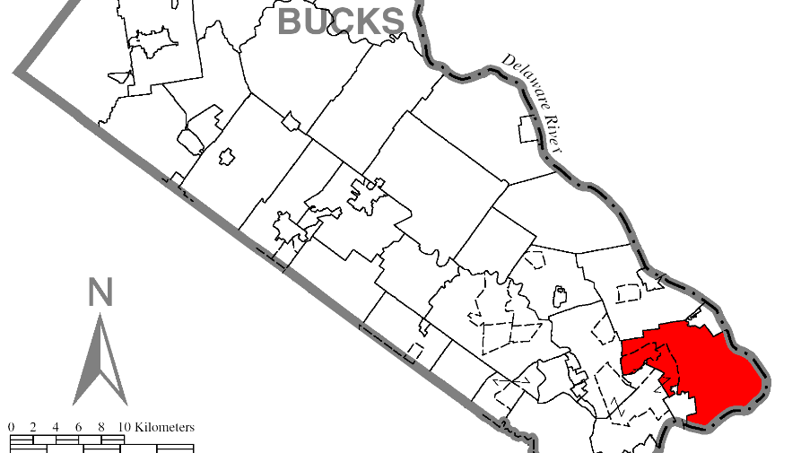
Falls Township

Slide 4

Demographics
Populations is :
84.1% Non-Hispanic White
5.8% African American
.2% Native American
4.2% Asian
4.4% Hispanic or Latino
2.1% Mixed

Slide 5

Demographics
13,170 households
9,403 families
Median age 36 years
U.S Route #1
Route 13
Interstate 95

Slide 6
Demographics
16 Apartment Complexes
8 Hotels/Motels
approximately 1200 Mobile Homes organized in 12 Trailer Parks

Slide 7

Pennsbury School District
Approximately 11,000 students
2 High Schools in Falls Township
5 Elementary Schools
+ Private Schools, daycares, twilight, alternative schools…

Slide 8
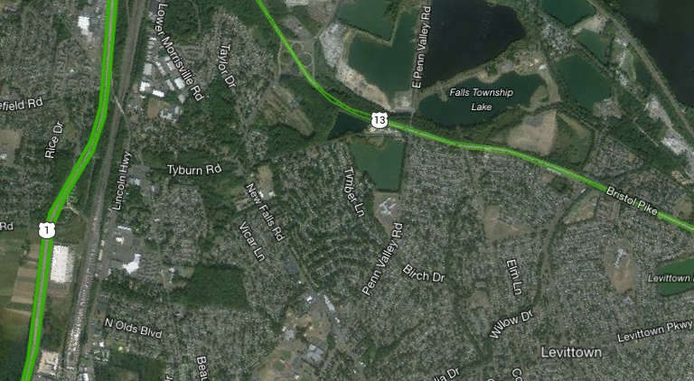
Falls Township

Slide 9

Falls Township Police Department

Slide 10
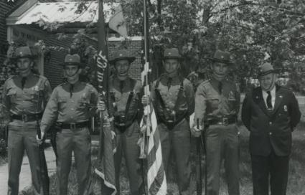
Police Department
Started in 1948 with the hiring of Franklin Kirby as a part time police officer.
Kirby was made Chief of Police in 1950. At that time, he remained the only officer.
By the 1959, the department had 28 officers.
  The population of Falls Township went from 3,540 in 1950 to 29,082 in 1960.

Slide 11
Police Department
53 Sworn Officers
Additional clerical and support personnel
Records Division
Evidence Custodian
Court Liaison
Range Officer
Accredited Agency by PA Chief’s of Police Association

Slide 12

Police Command Staff
Chief of Police
3 Lieutenants

Slide 13
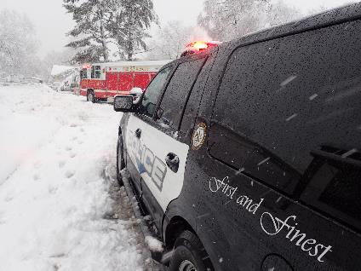
Patrol Division
“Tip of the Spear”
5 Sergeants
8 Corporals
27 Officers

Slide 14
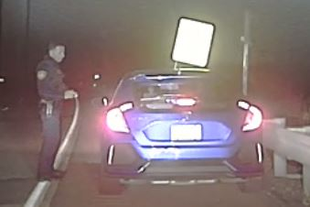
PATROL OBJECTIVES
To address drug related crimes and traffic crashes through aggressive proactive patrol.

Slide 15
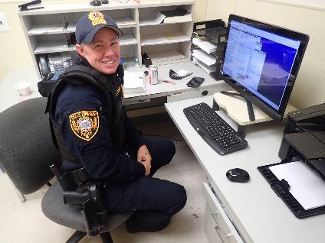
Patrol Uniform
FTPD was the first police department in Bucks County to transition to a tactical patrol uniform.

Slide 16
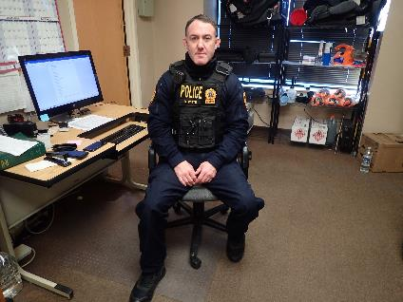
Patrol Uniform
Made by First Tactical, this military style uniform is made to work with external body armor. It is comfortable and practical for the environment today’s police officer works in.

Slide 17
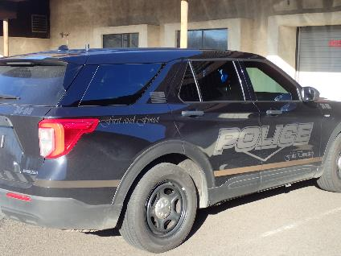
Patrol Division
FTPD uses “Ghosted” vehicles as well as black and white marked units in the patrol division.

Slide 18
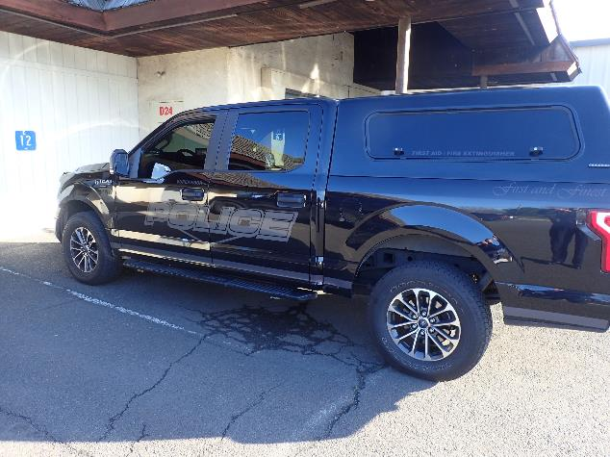
Patrol Division

Slide 19
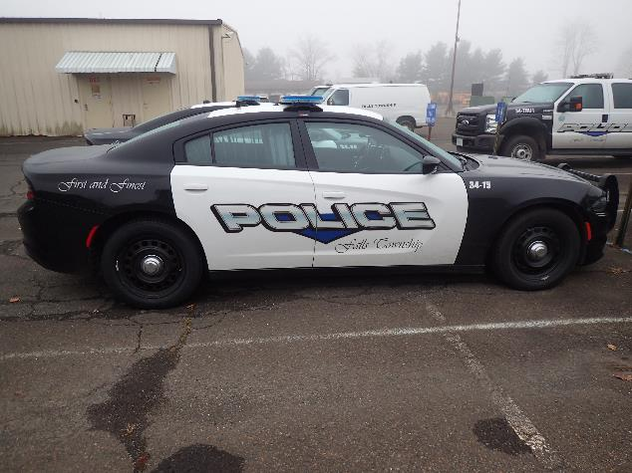
Patrol Division

Slide 20
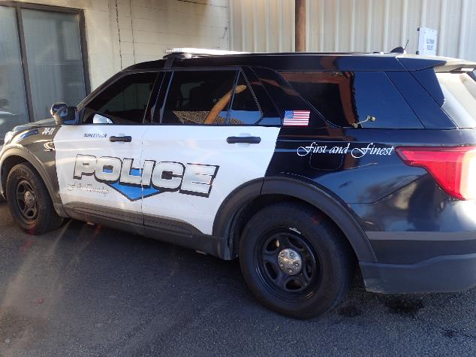
Patrol Division

Slide 21
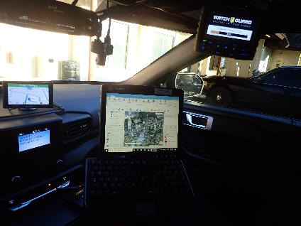
Patrol Vehicles Upfit with the Mission and Officer Safety in Mind
MACH (improved CLEAN access and GPS driven command, control and communications).
Watchguard in-car cameras.

Slide 22
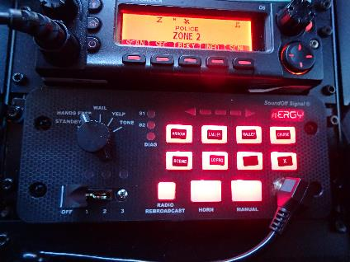
Patrol Vehicles Upfit with the Mission and Officer Safety in Mind
“Blueprint” siren and lighting controls.
  Slower flash pattern in park.
  Reduced intensity at night.
  2 externally mounted 100 watt speakers.
  Additional low frequency siren to assist in obtaining the right of way.

Slide 23

Patrol Vehicles
Mobile Data Terminal
Shotgun (Remington 870P)
Rifle (AR-15)
Go bag containing extra AR-15 magazines, tourniquet and other medical equipment
Fire extinguisher
First Aid kit
Flares

Slide 24
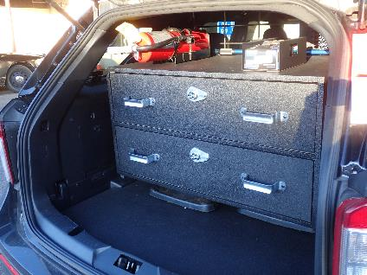
Patrol Vehicles
Custom lockable drawers in rear to organize emergency equipment.

Slide 25
Detective Division

Slide 26

Detective Division
1 Sergeant
6 Detectives
1 Administrative Assistant

Slide 27
Specialized Units
SWAT
EMT
Traffic Accident Investigation
Crisis Negotiation
Drug Investigations
K9
Snipers
MIRT
Federal Motor Carrier Inspection
Field Training Officer

Slide 28
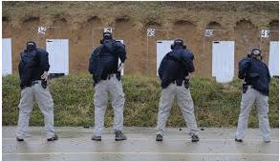
Training
FTPD believes in aggressively pursuing and providing training opportunities for all personnel.
Firearms Qualification 3 times/year:
  Handgun
  Shotgun
  Patrol Rifle
Each officer is provided with a box of ammunition every month for practice.
FTPD has its own outdoor range that officers are permitted to use.

Slide 29
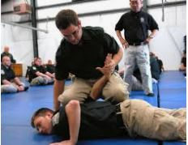
Training
Defensive tactics training is scheduled 3 times a year along with range training.
  Hand to hand combat.
  Weapon retention.
  Use of less lethal force options – Baton, Taser, Pepper Spray, etc…
  Force continuum.

Slide 30
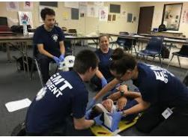
Training
First Aid / CPR training is every two years:
  Controlling major hemorrhaging through the use of tourniquets and wound packing.
  Use of AED, airways and BVM
  Use of Naloxone
Officers in the EMT program train every year for the required continuing education credits to maintain the state certification.

Slide 31
Interested?
I’m looking for a few good men and women to fill open job positions…
The next badge number to be issued is #128.

Slide 32
Ask yourself…
Do you have what it takes to do the best job in the world?

Slide 33
Uniforms
Newly hired Officers are issued:
  Two (2) badges
  Class A blouse coat and uniform
  Five (5) Uniform pants
  Five (5) Long Sleeve Shirts
  Five (5) Short Sleeve Shirts
  Gunbelt, holster and accessories.
  Winter jacket, hat, flashlight, baton, pepper spray, Taser
Boots
Riot helmet
Ballistic helmet
Baseball cap
Ballistic vest. Both internal and external vest carrier.
Smith and Wesson M&P .40 cal handgun

Slide 34
Uniform Allowance
Jan 1 2020: $953.00
  Cleaning is paid by the Township at designated cleaners.

Slide 35
FTPD Work Schedule
All uniform employees are assigned to twelve (12) hour work shifts.
Four (4) patrol squads are established with two (2) squads assigned to dayshift or night shift.
14 day rotation:
  M TWTFSSMTWTFSS
  XXOOXXXOOXXOOO

Slide 36
FTPD Shift Differential
Paid annually during first pay cycle in December.
$2,860.00 for 1900 – 0700 shift.

Slide 37
FTPD Salary Schedule
2020:
  Non-certified: $66,610.63
  Certified: $75,928.42
  1YR Patrol $86,259.13
  2YR Patrol $101,742.16
  3YR Patrol $106,905.13

Slide 38
FTPD Salary Schedule
Detective $111,233.92
Corporal $114,416.88
Sergeant $121,173.80

Slide 39
Historical Note
When I was hired in 1988, the salary for a non-certified officer was $18,400. Adjusted for inflation, that is $40,499 in today’s dollars.
I took a pay cut to become a Falls Township Police Officer.
This job is a calling to serve. This is not about money.

Slide 40
Educational Incentives
30 college credits: 1% of salary
60 college credits: 1.5% of salary
90 college credits: 2% of salary
Bachelor’s Degree: 2.75% of salary
Master’s Degree: 3.25% of salary

Slide 41
FTPD Vacation Time
40 hours after one (1) year
80 hours after two (2) years
120 hours after five (5) years
160 hours after ten (10) years
200 hours after fifteen (15) years
240 hours after twenty (20) years

Slide 42
FTPD Holidays and Kelly Time
96 hours off with pay in lieu of holidays each year.
Kelly time issued at rate of 1.5 hours for each hour scheduled in excess of 2080 hours.
Two (2) personal days (12 hours each) per year.
Every ninety (90) days without an incident of sick time, the employee is granted an additional 12 hours of personal time.

Slide 43

Health Care
No employee contribution.
IBC Personal Choice Option PPO.
Reimbursement program makes out of pocket costs in most cases:
  $5 co pay for doctor's visits.
  $2.50 generic and $5 brand name for prescriptions.
Annual stipend to offset gym membership costs.

Slide 44
Pension
Defined benefit pension.
25 years of service and age 50 years old.
DROP program for 5 ½ years.
50% of salary averaged in last 36 months of active duty.
COLA increases.
Additional cash stipend of $1600 / month toward medical benefits until age 65.

Slide 45
Competition
The hiring process is competitive in nature. You must be better than everyone else to be selected.
You must be self motivated, exceptional and above average in everything that you do.
  Appearance
  Public speaking
  Physical fitness
  Hand to hand combat
  Writing skills

Slide 46
Opportunity
Falls Township is a financially stable community.
Plans have been made to renovate the municipal building.
Plans are being discussed to increase the number of sworn officers.

Slide 47
Opportunity
Advancement:
  Detective Bureau
  Corporal
  Sergeant
Specialized training:
  SWAT, MIRT, Accident Investigation, Field Training Officer, Firearms Instructor, Defensive Tactics Instructor, Less Lethal Weapons instructor, Crisis Negotiation, EMT, truck inspection, K9, Drug Enforcement

Slide 48
Corporal

Slide 49
Sergeant

Slide 50
Opportunity
Join a professional, accredited police department.
Be on the front lines of the strategic vision for policing Falls Township.
Make a difference in the lives of the people you meet.

