Slide 1

FALLS TOWNSHIP
POLICE DEPARTMENT
Hiring Process and FTO Program
2023

Slide 2
Training
Firearms
  Handgun
  Shotgun
  Patrol Rifle
Monthly ammunition for practice
FTPD outdoor range for officers
Defensive tactics and range training 4 times a year
  Hand to hand combat
  Weapon retention
  Use of less lethal force options: baton, taser, pepper spray, etc.
  Force continuum
First Aid/CPR training every 2 years
  Controlling major hemorrhaging using tourniquets and wound packing.
  Use of AED, airways and BVM
  Use of Naloxone
Officers in the EMT program train every year for the required continuing education credits to maintain the state of certification.

Slide 3
Uniforms
Newly hired officers are issued:
  2 Badges
  Class A blouse coat
  4 uniform pants
  4 long sleeve shirts
  Gun belt, holster and accessories
  Winter jacket, hat, flashlight, baton, pepper spray, taser
  Ballistic vest, both internal and external carrier
  Smith and Wesson M&P .40 caliber handgun

Slide 4

Work Schedule
All uniform employees are assigned to twelve (12) hour work shifts.
4 patrol squads are established with two squads assigned to dayshift or night shift
14-day rotation:
  MTWTFSSMTWTFSS
  XXOOXXXOOXXOOO

Slide 5
2022 Salary Schedule
Non-Certified: $70,964.46
Certified: $82,124.18
1 Year Patrol: $93,297.87
2 Year Patrol: $110,044.32
3 Year Patrol: $115,628.59

Slide 6

Shift Differential
Paid annually during first pay cycle in December
$2,860.00 for 1900-0700 shift

Slide 7
Educational Incentives
30 college credits: 1% of salary
60 college credits: 1.5% of salary
90 college credits: 2% of salary
Bachelor’s Degree: 2.75% of salary
Master’s Degree: 3.25% of salary

Slide 8
Vacation Time
40 hours after 1 year
80 hours after 2 years
120 hours after 5 years
160 hours after 10 years
200 hours after 15 years
240 hours after 20 years

Slide 9
Holidays and Kelly Time
96 hours off with pay in lieu of holidays each year
Kelly time issued at rate of 1.5 hours for each hour scheduled in excess of 2,080 hours
2 personal days (12 hours each) per year
Every 90 days without use of a sick day, an additional 12 hours of personal time is issued.

Slide 10
Healthcare
No employee contribution
IBC Personal Choice Option PPO
Reimbursement program makes out of pocket costs in most cases:
$5.00 co-pay for doctors' visits
$2.50 generic and $5.00 brand-name for prescriptions
Free gym membership

Slide 11
Pension
Defined benefit pension
25 years of service and 50 years old
DROP program for 5 ½ years
50% of salary averaged in last 36 months of active duty
COLA increases
Additional cash stipend of $1,700/month toward medical benefits until age 65

Slide 12
Opportunity
Falls Township is a financially stable community
Increasing the number of sworn officers
Advancement
Detective Bureau
Corporal
Sergeant
Specialized Training
SWAT, MIRT, Accident Investigation, Crisis Negotiation, EMT, Truck Inspection, K9, Drug Enforcement
Join a professional, accredited police department
Be on the front lines of strategic vision for policing Falls Township
Make a difference in the lives of the people you meet

Slide 13
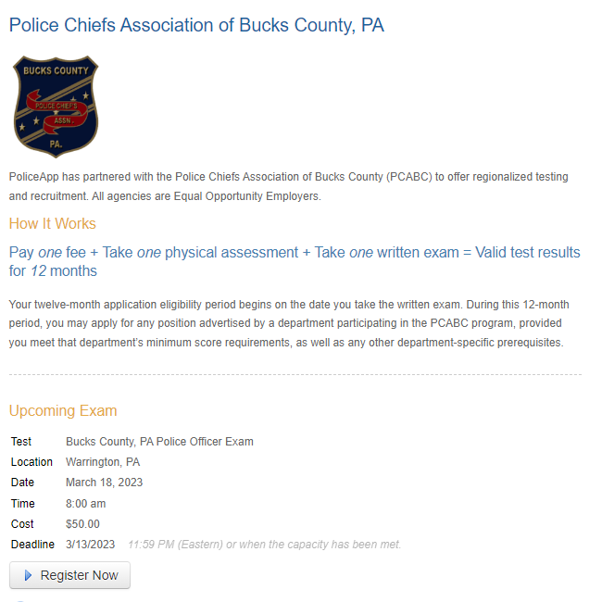
Applications
All candidates will be required to take the Bucks County Consortium Test. Applications are submitted through www.policeapp.com

