Slide 1



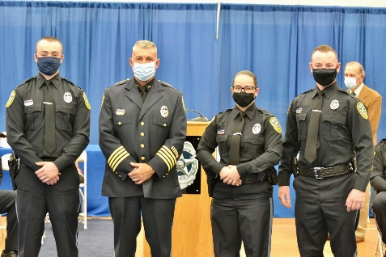
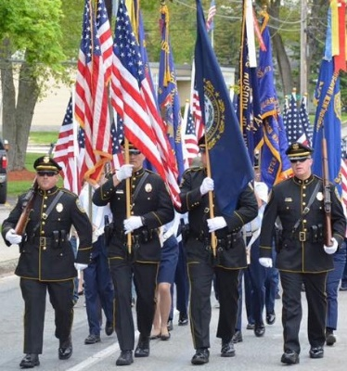



Hudson Police Officer Testing
Date: Thursday, June 15, 2023
Time: 5 PM
Location: Alvirne High School
200 Derry Street
Hudson, NH 03051
-Applications are available at
www.PoliceApp.com/HudsonNH
-Application deadline is June 13, 2023.
- Certified officers starting range: $63,587.44 - $72,259.44
-Non-Certified officers starting salary: $60,660.64
-For more information, contact Master Patrol Officer Ronald Cloutier at (603)816-2272.
The Hudson Police Department is an Equal Opportunity Employer.
All are encouraged to apply.

